Slide 1

Ready2plate
GROUP 4
A restaurant app
Alejandro Suntay, James Talbott, Nirmalya Ghosh, Phuc To

Slide 2
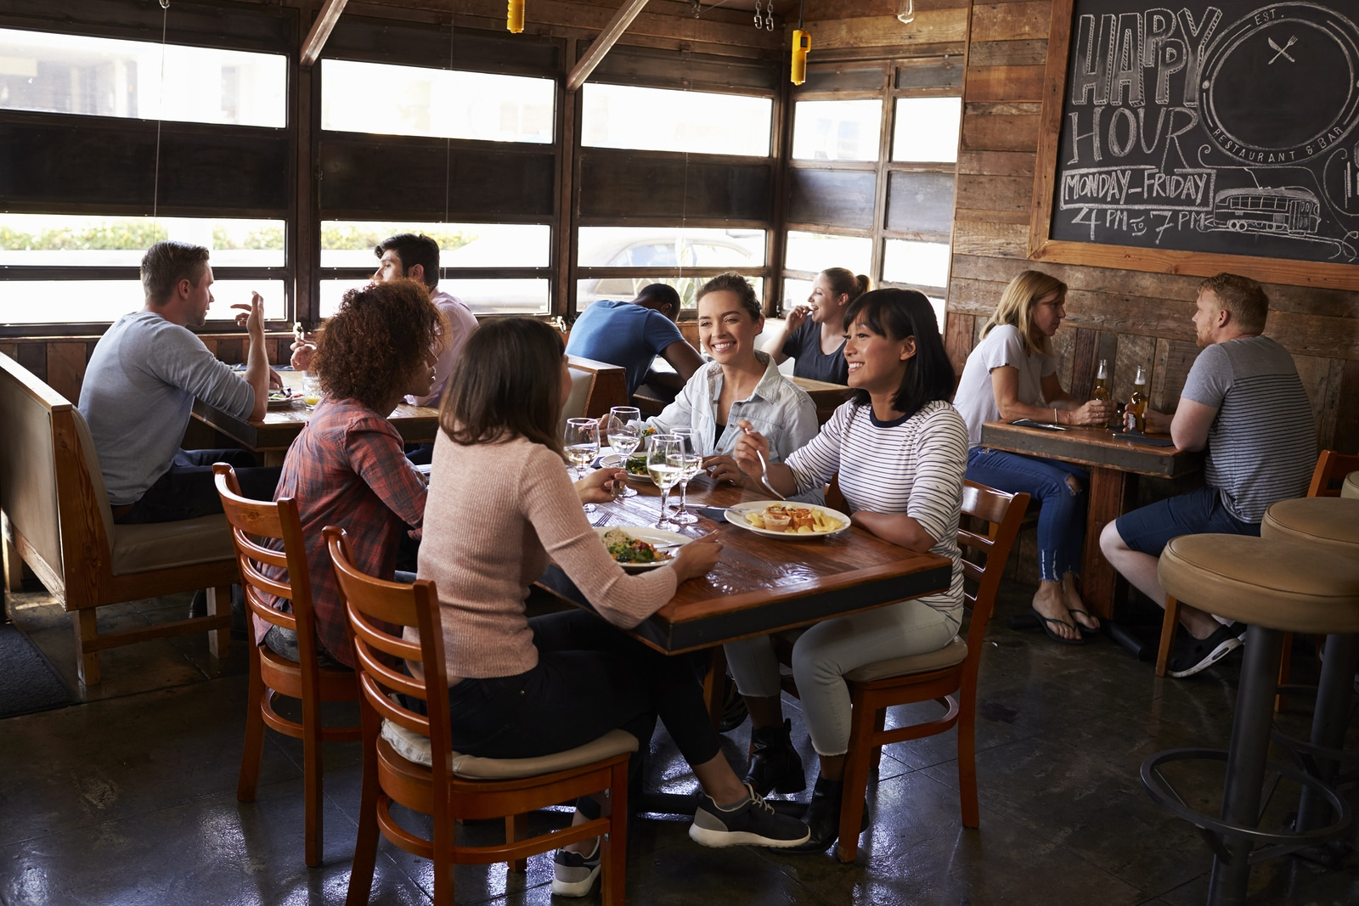
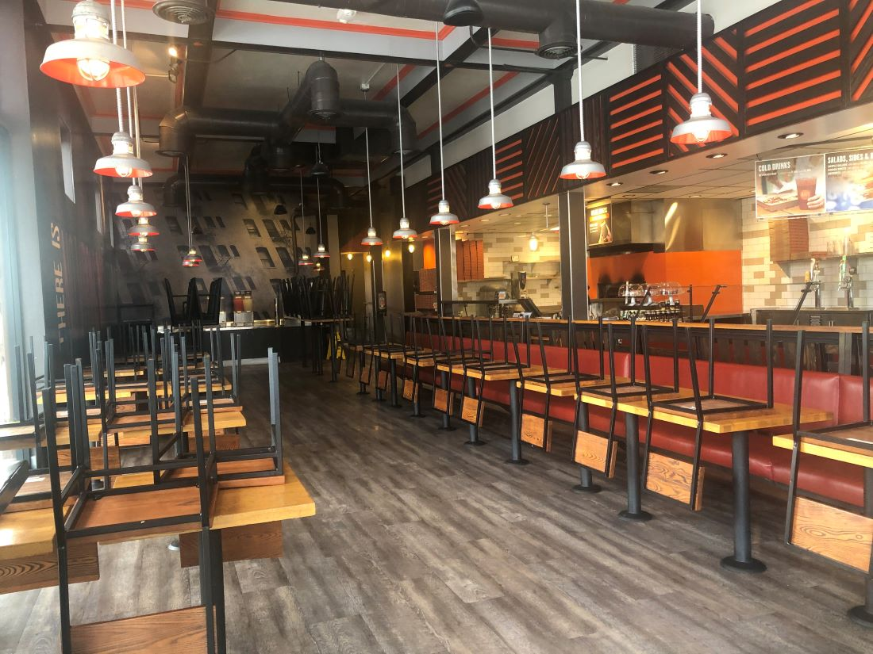
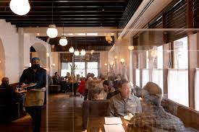
The TIMELINE
2019
2020
2021
Restaurants Operating Normally
COVID-19
Restaurants Forced To Adapt
Notes:
1. Life is normal as ever. People are eating out all the time and there is always a new place to eat in the neighborhood.
2. During the pandemic, restaurants all over the world saw what a lockdown could do to their business. The regular way of serving customers was deemed harmful to public health. Food ordering apps helped keep restaurant businesses afloat during strict lockdown periods. This teaches us that the most relied upon food-industry needs to upgrade their way of serving their customers with the help of technology. As restaurants begin to open, many restaurants have decided to rethink the way they operate. From limited capacity, promoting take-outs, reservation, temperature screenings, etc. One crucial part of restaurant business that remains the same is how customers order food at the table.
3. With Ready2Plate, customers will have the flexibility of ordering food right on the table, regardless of how busy the restaurant is. No more asking the staff about their late food order. They can track the progress right from the app. Kitchen will receive your order instantaneously and get to work!

Slide 3
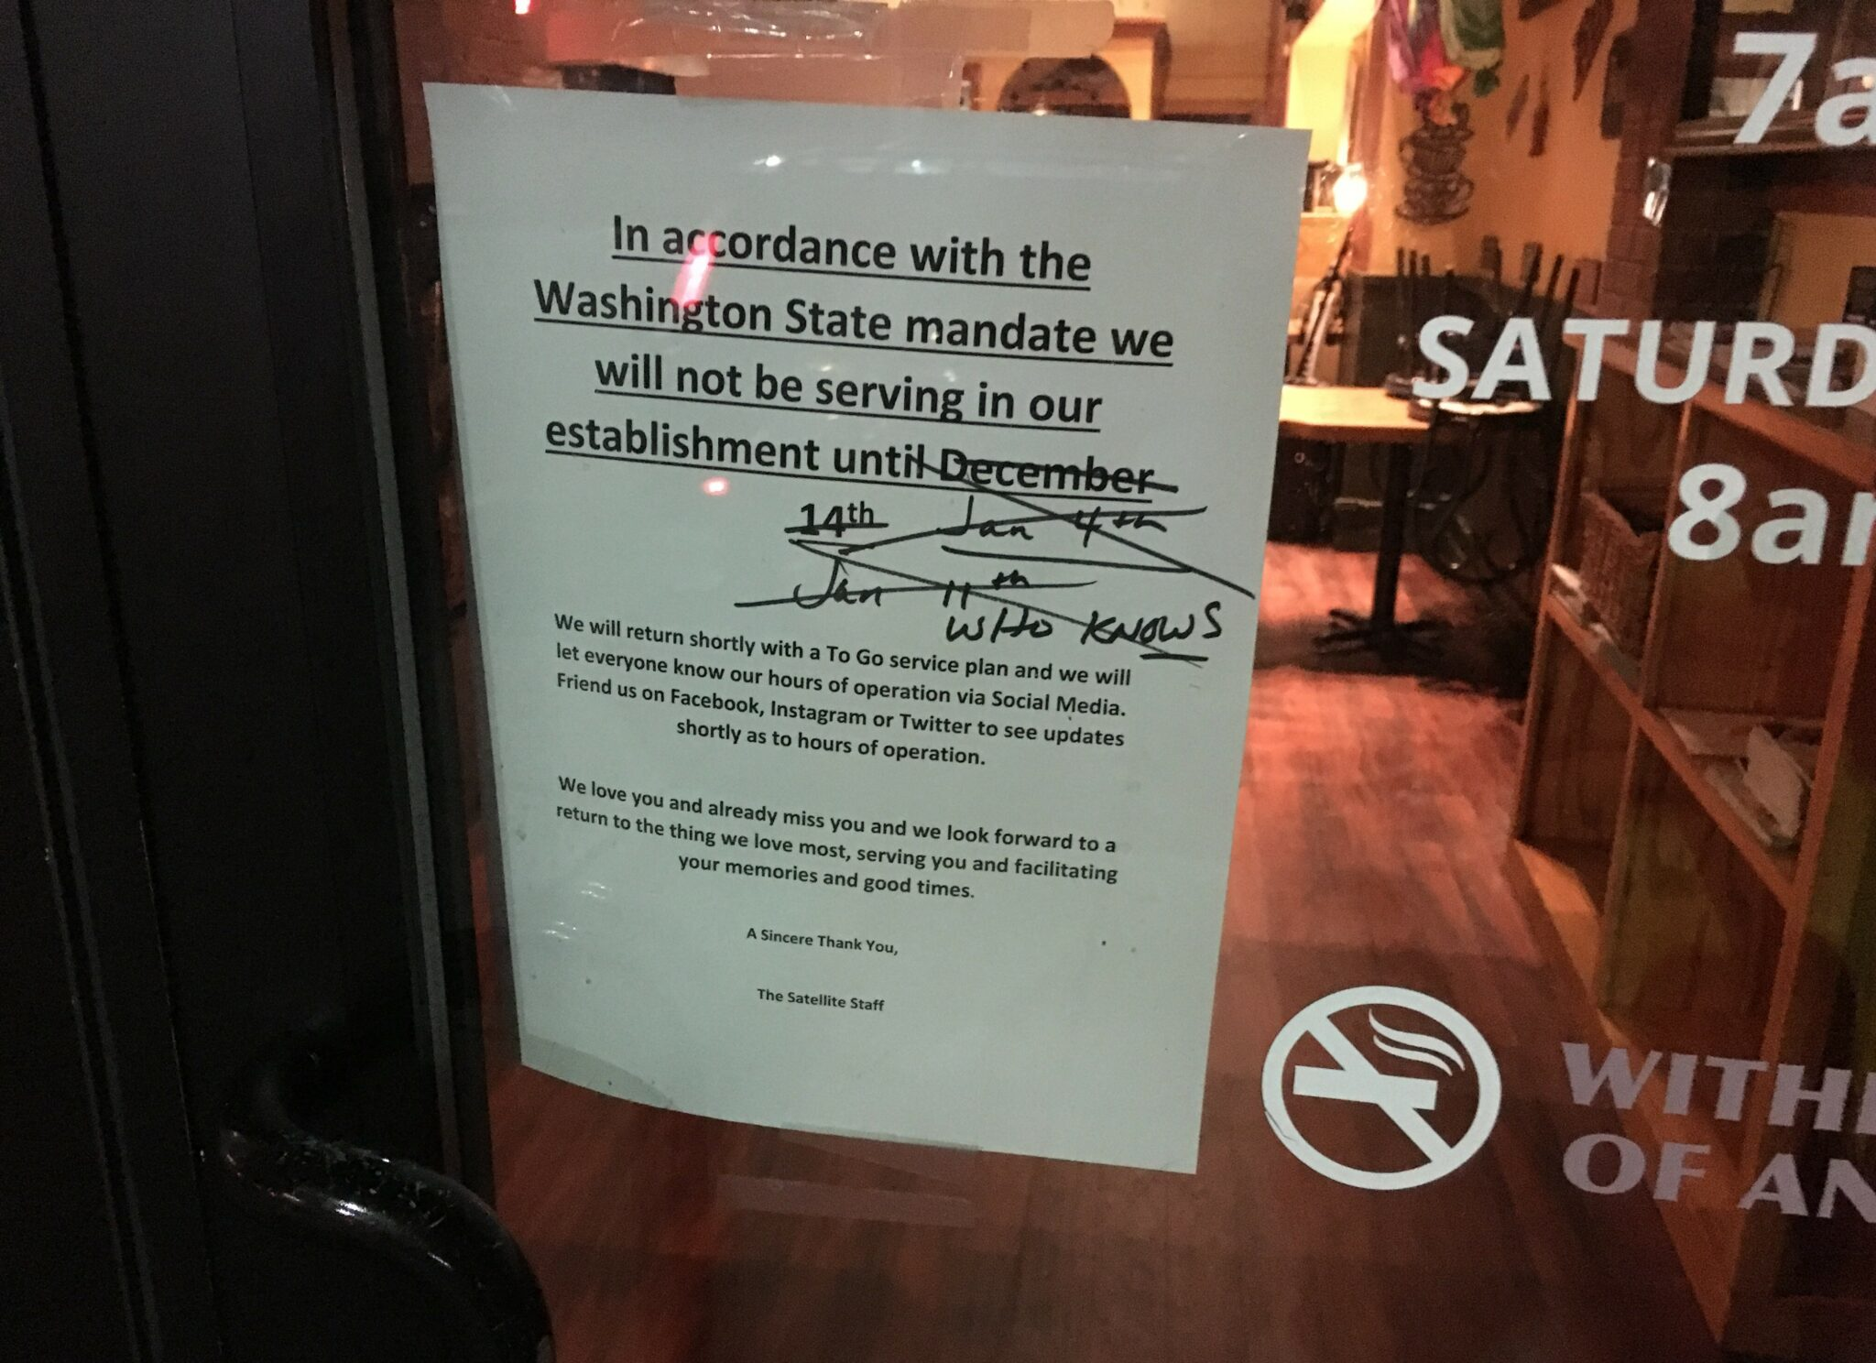
The Problem
COVID Modifications
Reduced Foot-traffic
Reduced Capacity
Reduced Staff
Reduced Profit
Restaurants are short staffed.
Higher demand than ever.
Notes:
Because of the pandemic, some restaurants have been forced to close. Of those that remained open, an altered version of service is required.

Slide 4
The SOLUTION – Ready 2 Plate
Decreased human contact.
Streamlined ordering process.
Addresses staffing issues.
Increases profit margin.
Decreases owner and staff workload.
Affordable alternative to POS systems.
Notes:
Restaurants are short staffed but the demand for dine-in is higher than ever.
In order to help restaurants, take on high demand, our tool will allow them to directly place an order through their phone while the customers are dining-in.
This eliminates the need of waiters to manually take orders from every table.
From order taking to inventory management, our application excels in complete restaurant management. With digitized inventory system that can be updated real-time based on the amount of ingredient used in an entrée, the system can automatically fulfil restocking of the items right from the suppliers. Suppliers can also keep track of the demand from various restaurants.

Slide 5
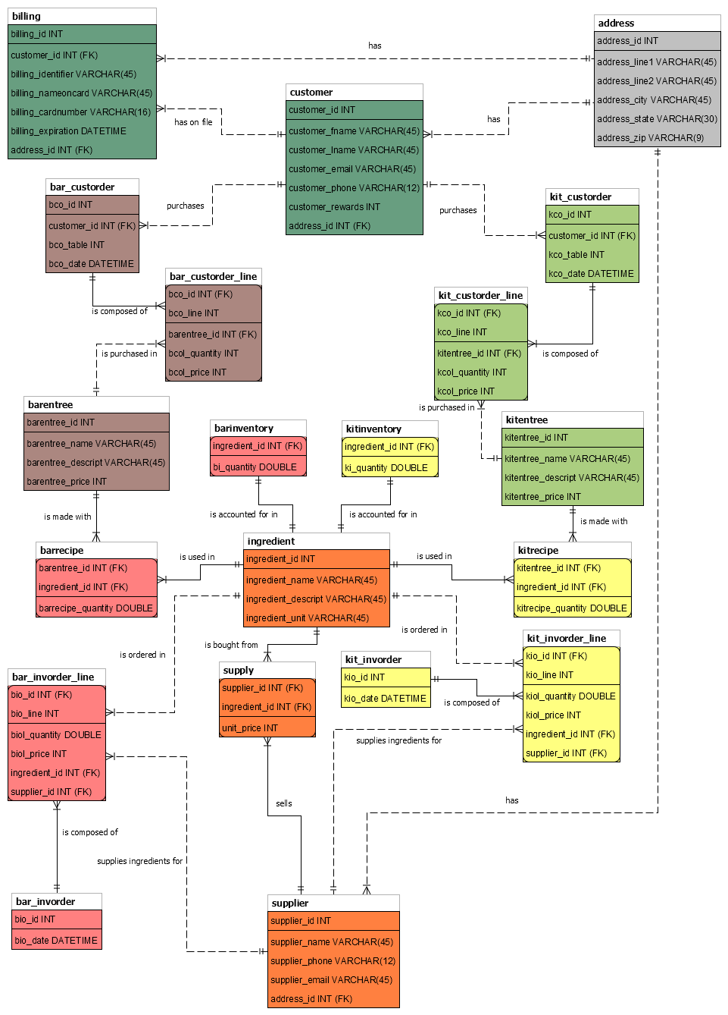
The database
Overall database structure, grouped by colors.
Only the owner can have total access to the whole database, others can only access their respective parts.

Slide 6
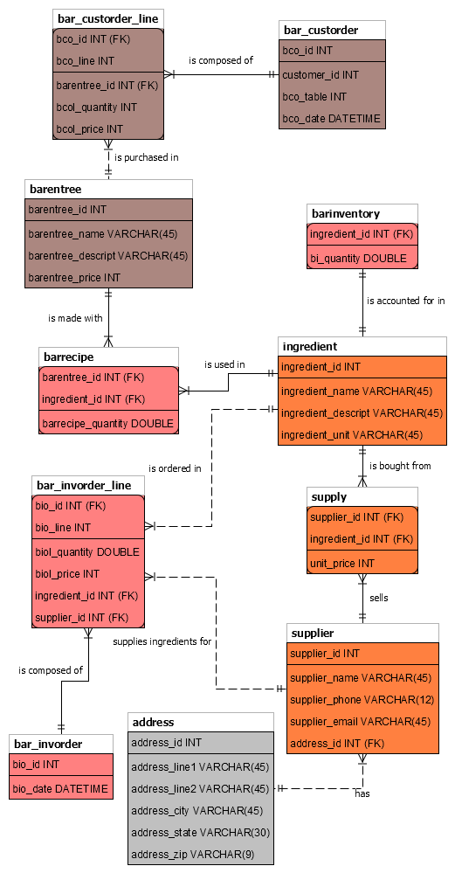
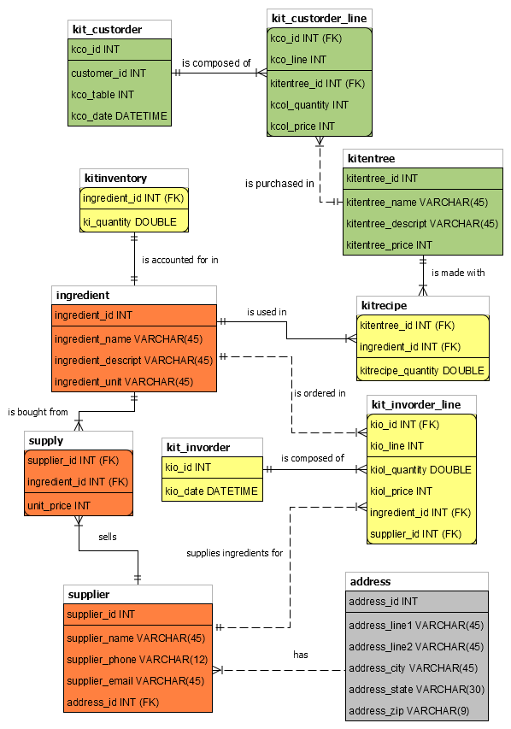
Manager access
Kitchen and Bar separated for clearer order and inventory management.

Slide 7
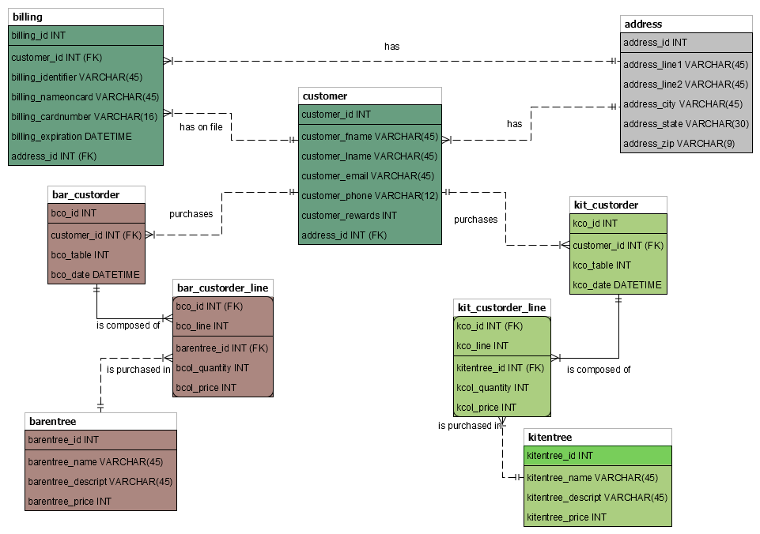
Wait staff – customer level access
Both wait staff and customer share the same access to the database, with different privilege.
Wait staff oversee monitoring the flow of customers and entrées from the kitchen/bar.
Customer can only access their own data.

Slide 8

THE APP
DEMO
Notes:
If we decide to not do a live demo, we can take this slide out

Slide 9
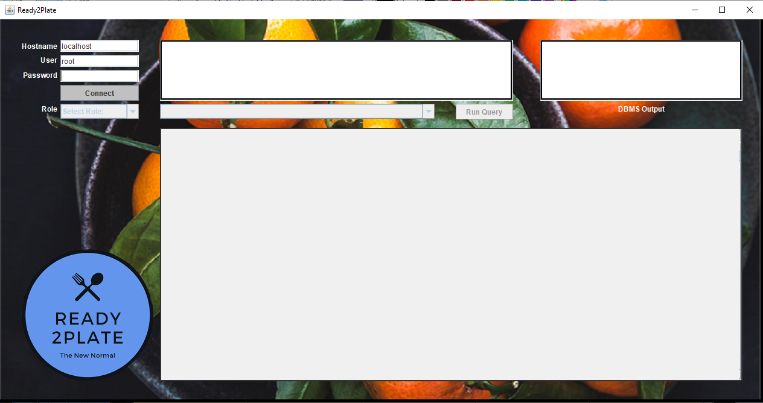
Startup screen

Slide 10
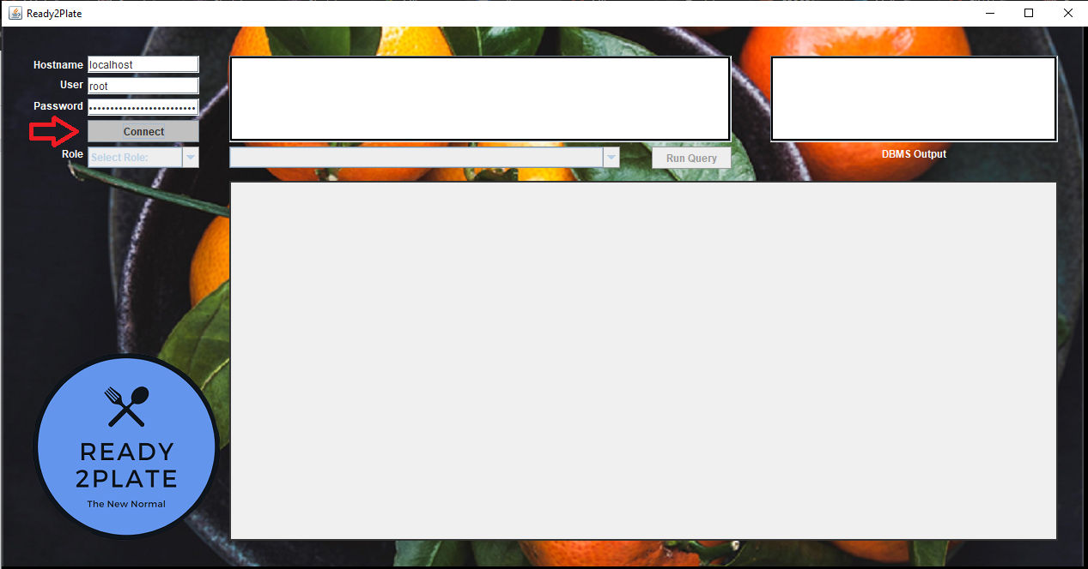
Step 1: Connect to Database

Slide 11
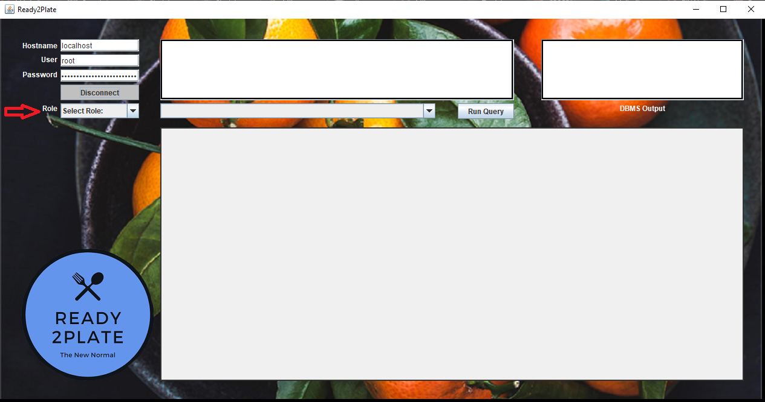
Step 2: Select Role

Slide 12
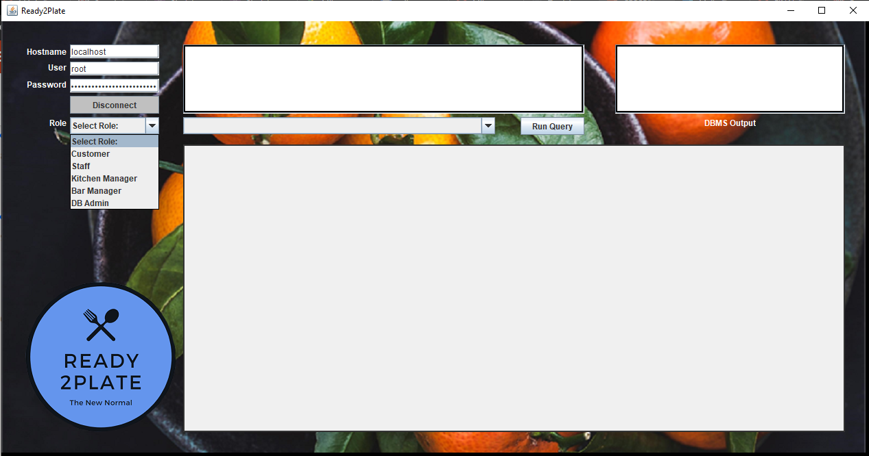
Available Roles

Slide 13
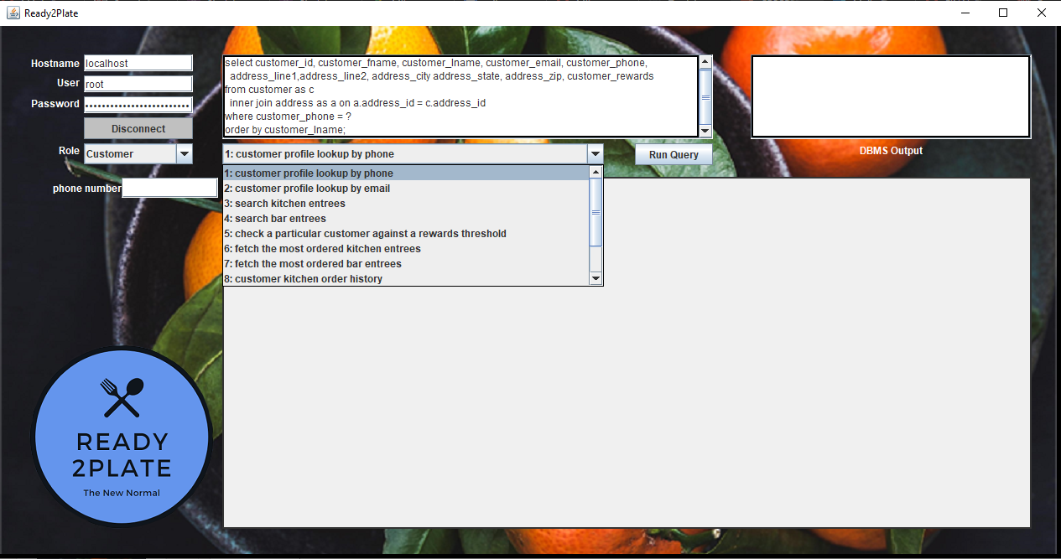
Customer Role Query List

Slide 14
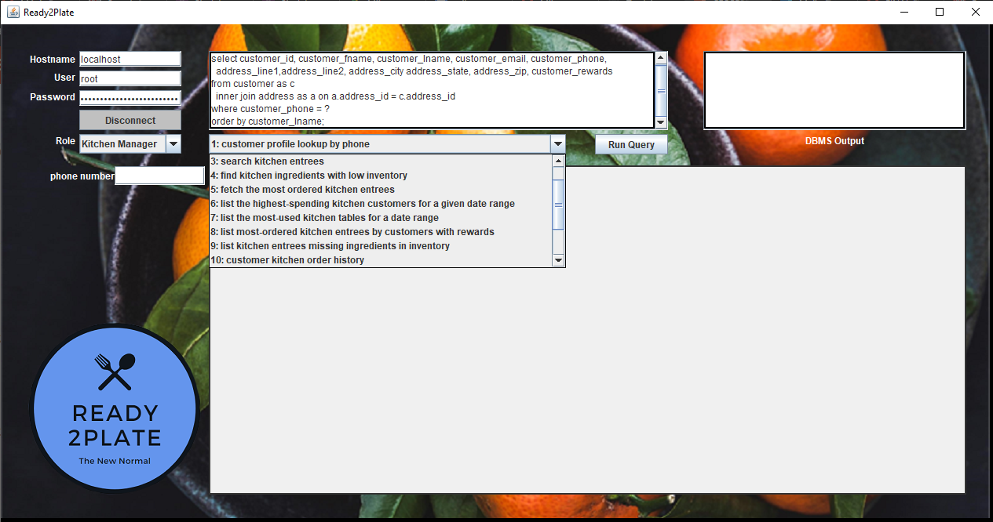
Manager Role QUery list

Slide 15
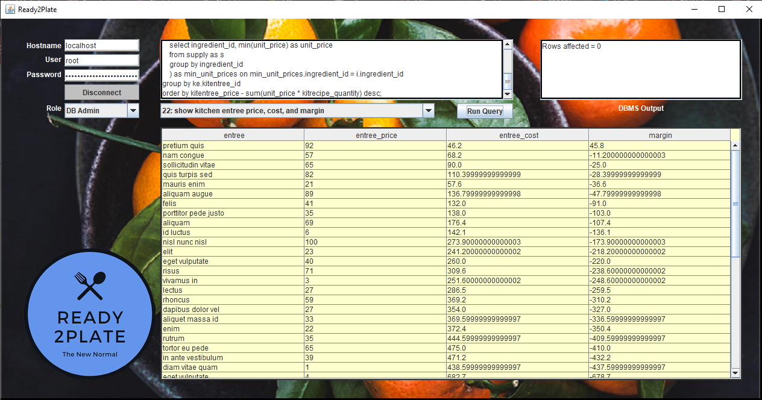
Simple Query

Slide 16
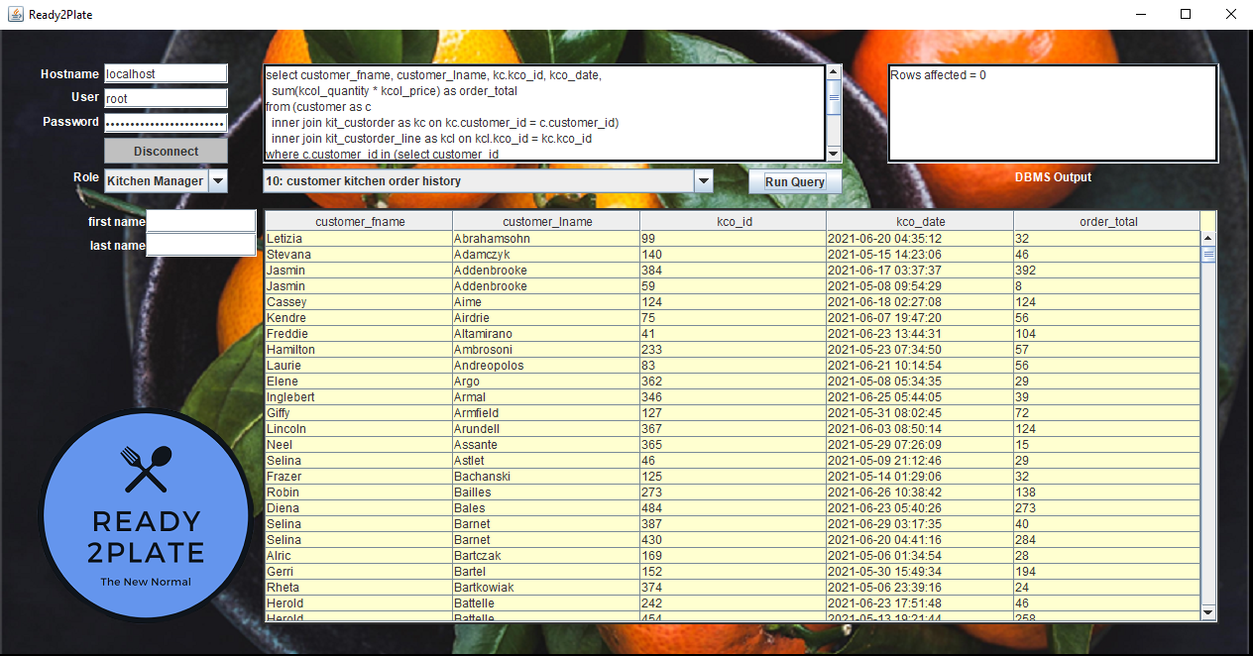
Query With String-type like parameter

Slide 17
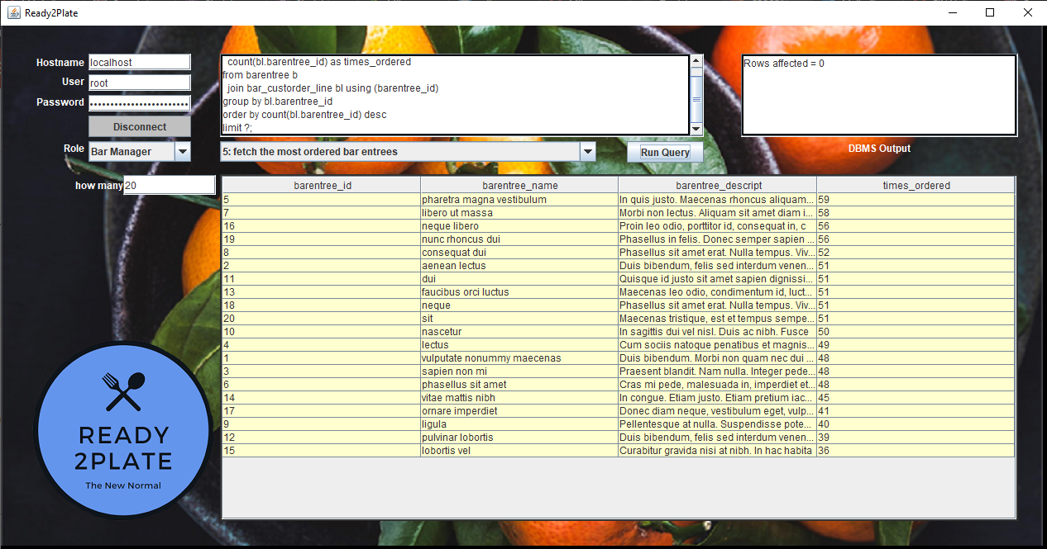
Query with int-type parameter

Slide 18
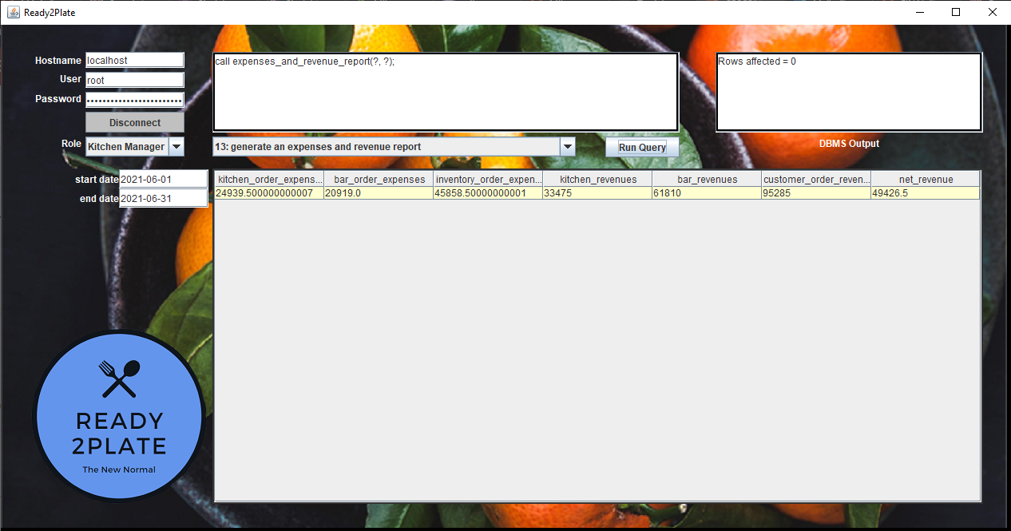
Query with date-type parameters

Slide 19
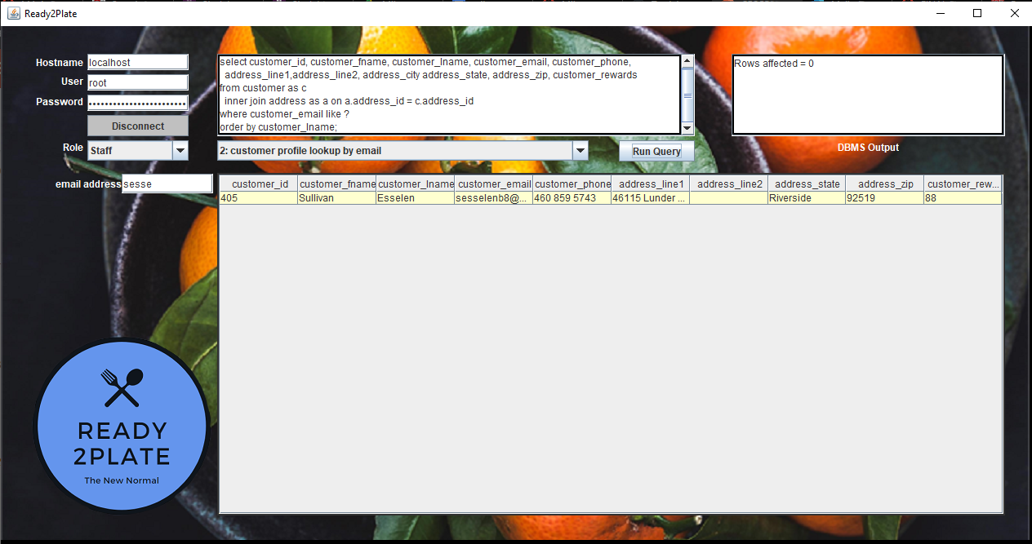
Placing An Order: 1. Lookup customer profile

Slide 20
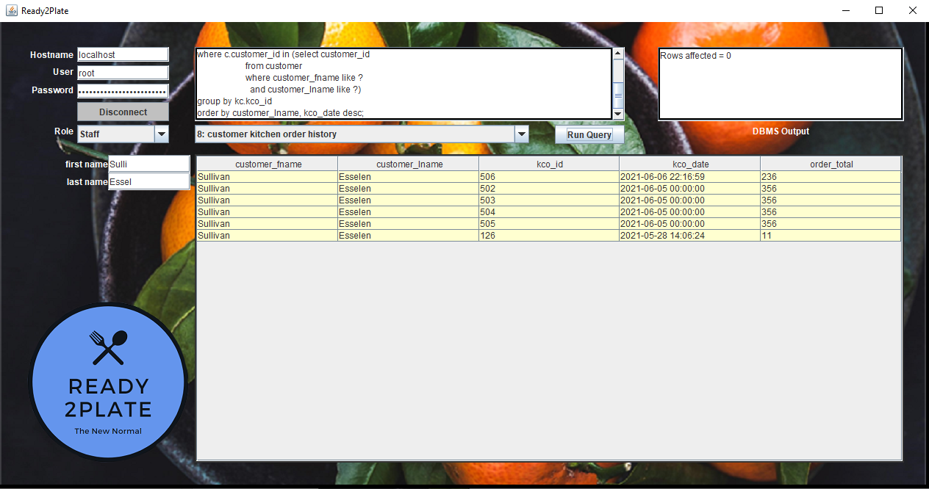
2. Customer order history for reference

Slide 21
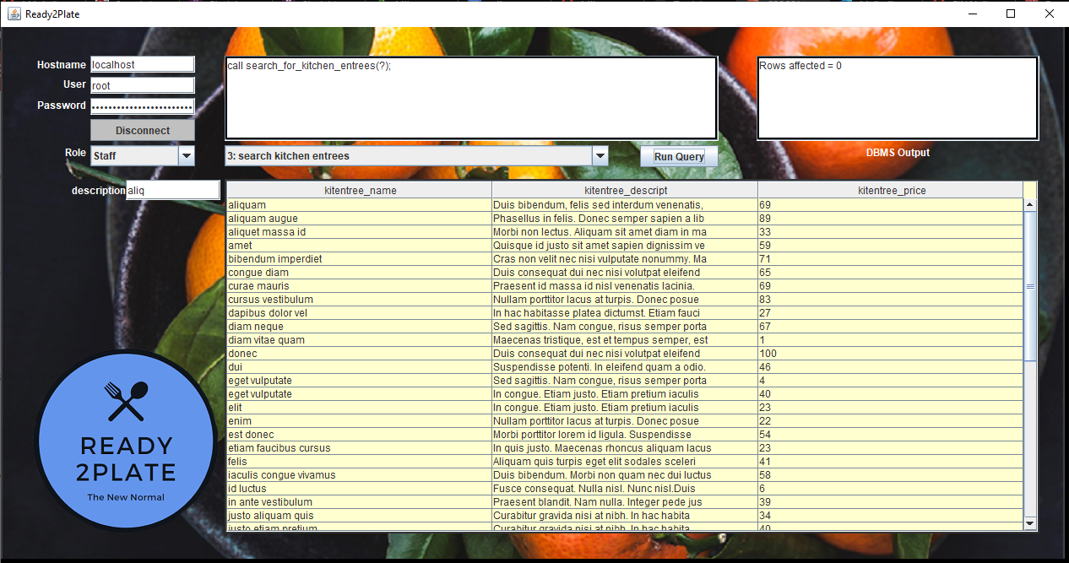
3. Lookup delicious entrees

Slide 22
4. Place the order

Slide 23
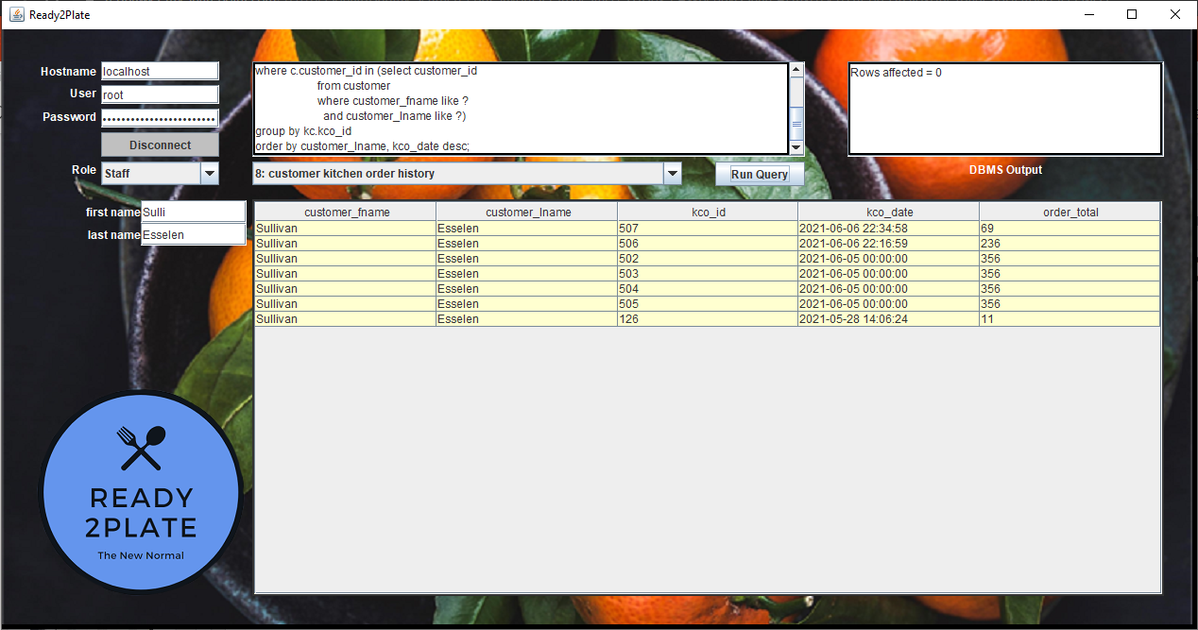
5. The new order appears in the customer’s history

Slide 24
6. And this query looks up the order lines

Slide 25

7. Observe the triggered rewards increment

Slide 26

Conclusion
Advantage
Value
Improvement
We allow restaurants to take orders quickly and be more efficient.
Value to diners with a contactless and faster way to order food.
Streamlined in-person experience.
Less waste!
Better financial planning ability.
Organized order and supply format.
Safer environment for restaurant reopening for dine-in.
Easier restaurant management.

Slide 27
Room for improvement
Initial Improvements
Develop app GUI
Development
Web/Mobile implementation with corresponding tools and APIs
Execution
Simplified App Flow (UX/UI)
CI/CD
Minor tweaks to QOL
Marketing Campaign
Code/Runtime Efficiency
Hardware Dev RND
Notes:
Google analytics for restaurant owners and managers

Slide 28

Thank you

Slide 29

Question & anSwers

